Slide 1

HEART DISEASE DIAGNOSTIC ANALYSIS
UNIFIED MENTOR INTERNSHIP | August – October 2024
Presented By: Dr. Nandini Arvind
Data Analytics & Business Intelligence | Data Science

Slide 2
OBJECTIVE
The goal of this project is to analyze the heart disease occurrence, based on a combination of features that describes the heart disease.
You are required to analyze this health and medical data for better future preparation.
Do ETL: Extract- Transform and Load data from the heart disease diagnostic database
you can perform EDA through python.
The database extracts various information such as Heart disease rates, Heart disease by gender, by age.
You can even compare attributes of the data set to extract necessary information.
Make the necessary dashboard with the best you can extract from the data.
Use various visualization and features and make the best dashboard.
Find key metrics and factors and show the meaningful relationships between attributes.

Slide 3
DATA DICTIONARY:
Age, Sex (1 = male, 0 = female)
cp: The chest pain experienced (Value 1: typical angina, Value 2: atypical angina, Value 3: non-anginal pain, Value 4: asymptomatic).
trestbps: The person's resting blood pressure (mm Hg on admission to the hospital)
chol: The person's cholesterol measurement in mg/dl
fbs: The person's fasting blood sugar (> 120 mg/dl, 1 = true; 0 = false)
restecg: Resting electrocardiographic measurement (0 = normal, 1 = having ST-T wave abnormality, 2 = showing probable or definite left ventricular hypertrophy by Estes' criteria)
thalach: The person's maximum heart rate achieved
exang: Exercise induced angina (1 = yes; 0 = no)
oldpeak: ST depression induced by exercise relative to rest
slope: the slope of the peak exercise ST segment (Value 1: upsloping, Value 2: flat, Value 3: down sloping)
ca: The number of major vessels (0-3)
thal: A blood disorder called thalassemia (3 = normal; 6 = fixed defect; 7 =reversable defect)
num: Heart disease (0 = no, 1 = yes)

Slide 4
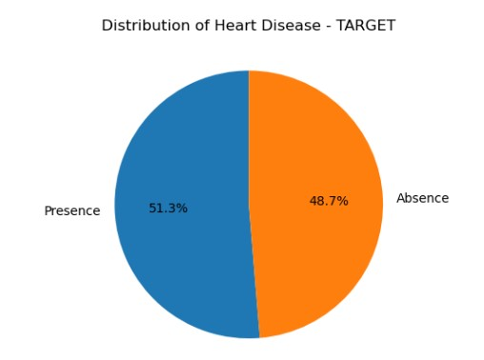
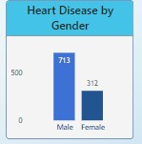
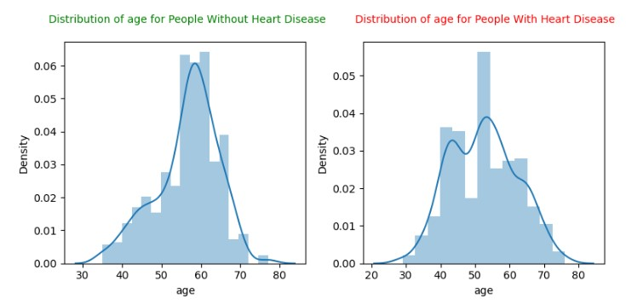
WHAT KIND OF POPULATION DO WE HAVE ?
51.3% People suffering from heart disease.
Males are more prone to heart disease.
Elderly Aged People (>55) are more in our population.
People over 55 are predominantly affected by heart disease, with a peak incidence observed among middle-aged individuals between 40 and 45 years.

Slide 5
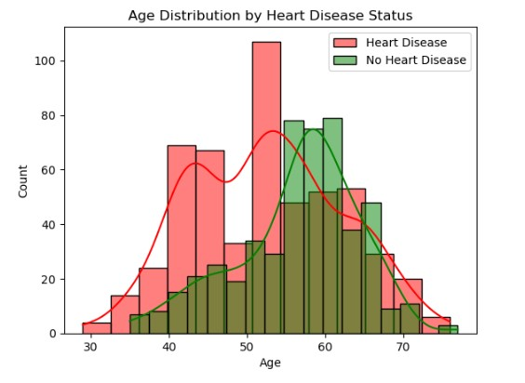
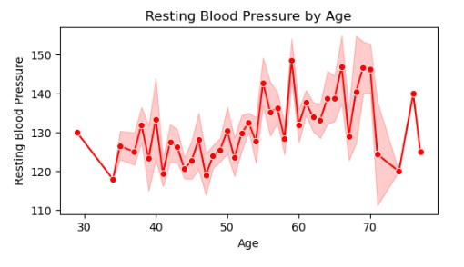
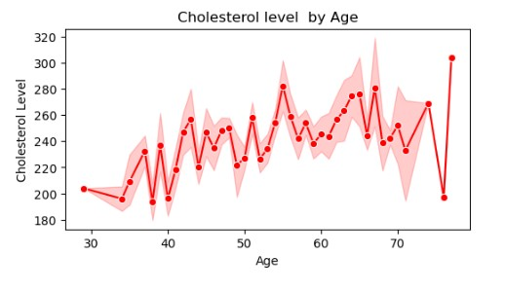
AGE-DRIVEN INCREASE IN PARAMETERS LEADING TO HEART DISEASE
People over 55 are predominantly affected by heart disease, with a peak incidence observed among middle-aged individuals between 40 and 45 years.
Resting blood pressure shows an upward trend starting around age 55, rising from 130 mmHg and increasing thereafter.
Cholesterol levels also increase gradually with age, peaking around 260-300 mg/dL after age 55 and showing fluctuations in later years.
Cholesterol increasing in the age group of 50-60. A smaller subset showing extremely high levels.

Slide 6
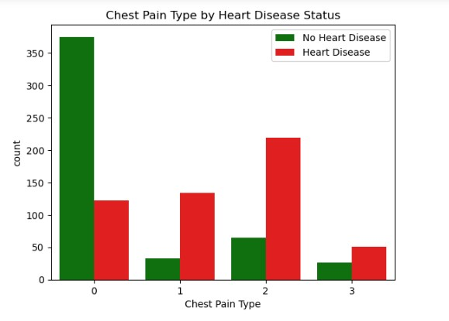
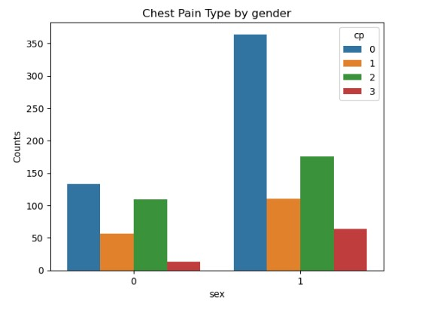
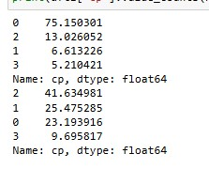
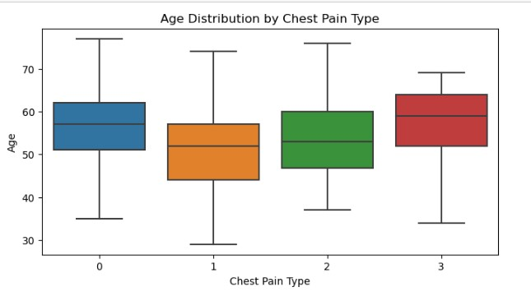
TYPE 2 CHEST PAIN IN AGED MALES
People having Type 2 chest pain have a higher chance of heart disease relatively.
Males (1) are more prone to be affected than females.
Type 2 chest pain is a strong predictor of heart disease, accounting for 41.63% of cases.
Elder age People 55+ years are mostly affected by heart disease.

Slide 7
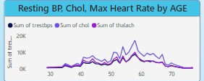
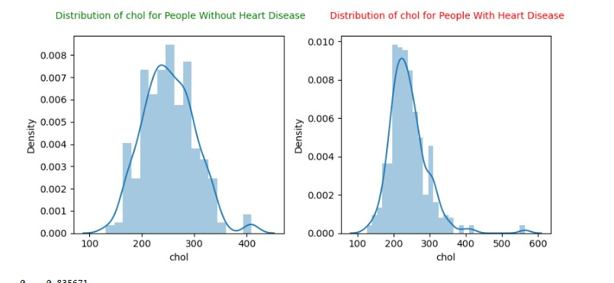
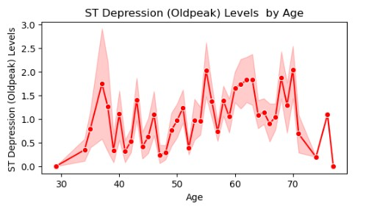
AGE-RELATED RISE, MORE COMMON IN MALES
Resting blood pressure trends upward with age ,particularly in individuals aged 55 and older.
Also, indicating a subset with significantly higher values and no major gender difference in resting blood pressure levels.
Maximum heart rate Increasing in the age group of 50-60. A smaller subset showing extremely high levels.
ST depression mostly increases between the age group of 50-65. Males tend to have higher old peak levels than females.

Slide 8
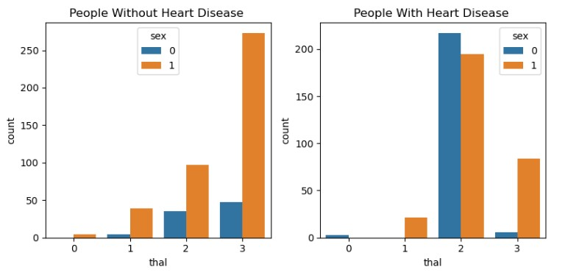
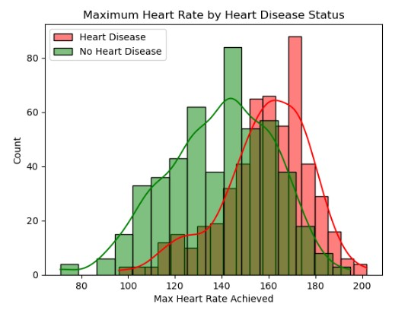
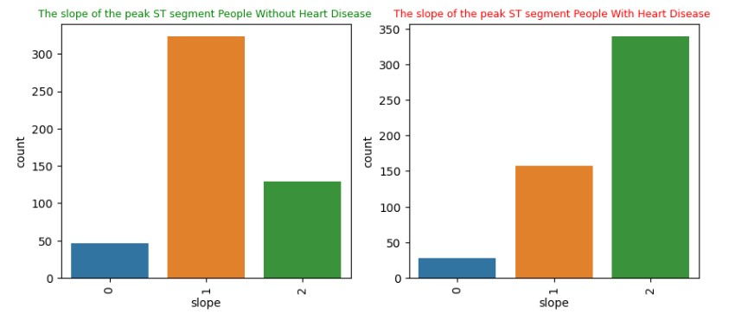
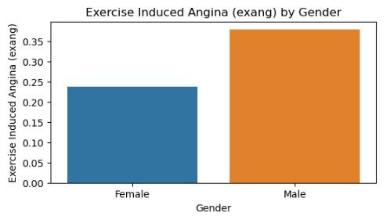
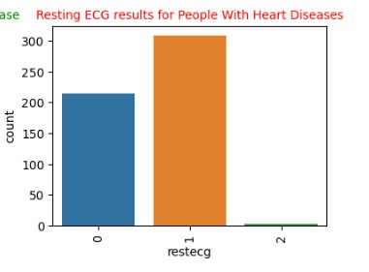
OTHER PEAKING PARAMETERS
Individuals with thalassemia category 2 (reversible defect) are more prone to heart disease.
Females exhibit a relatively higher incidence of thalassemia, which could be relevant in heart disease risk analysis.
Males are more affected by heart disease than females and are more likely to experience exercise-induced angina, which is linked to heart disease.
Maximum Heart Rate is slightly higher in Heart Disease individuals with mean around 160 mm/Hg.
The slope of the peak ST segment with a value of 2 is associated with a higher likelihood of heart disease.
Resting ECG values of 1 are frequently associated with heart disease, though they are also observed among individuals without heart disease, showing no significant difference in prevalence.

Slide 9
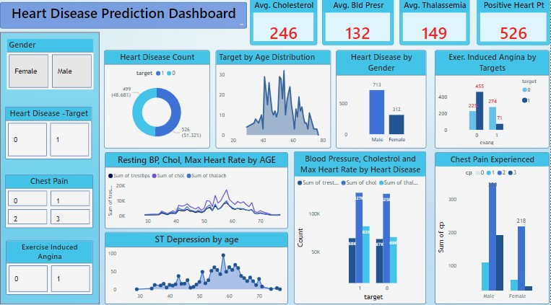

Slide 10
KEY PERFORMANCE INDICATOR (KPI)
Heart disease is strongly and positively correlated with chest pain (cp), maximum heart rate achieved (thalach), and the slope of the peak exercise ST segment (slope).
Age shows a positive correlation with resting blood pressure (trestbp) and the number of major vessels involved (ca).
A higher maximum heart rate (thalach) is directly associated with chest pain (cp) and the slope of the peak exercise ST segment (slope), which are both indicators of heart disease.
Exercise-induced angina has a positive relationship with ST depression induced by exercise relative to rest (oldpeak).
There is a strong negative correlation between ST depression induced by exercise (oldpeak) and the slope of the peak exercise ST segment (slope).
Heart disease shows a high negative correlation with both exercise-induced angina (exang) and ST depression (oldpeak).

Slide 11
FINAL INSIGHTS:
51.30% People suffering from heart disease with Males being more prone.
Type 2 chest pain is a strong predictor of heart disease, accounting for 41.63% of cases, making it a critical indicator for assessing heart health.
People over 55 years are predominantly affected by heart disease, with a peak incidence observed among middle-aged individuals between 40 and 45 years.
Resting blood pressure shows an upward trend starting around age 55, rising from 130 mmHg and increasing thereafter.
Cholesterol levels also increase gradually with age, peaking around 260-300 mg/dL after age 55 and showing fluctuations in later years.
Individuals with thalassemia category 2 (reversible defect) are more prone to heart disease.
There is a strong negative correlation between oldpeak and the slope of the peak exercise ST segment (slope), indicating that high ST depression levels may be less likely as slope values increase.
Resting ECG values of 1 are frequently associated with heart disease, though they are also observed among individuals without heart disease, showing no significant difference in prevalence.
ST depression mostly increases between the age group of 30-40.

Slide 12
CONCLUSION
Recommendations for Heart Disease Prevention and Management
Enhanced Screening: Incorporate chest pain type, cholesterol levels, and maximum heart rate as standard measures in heart disease risk assessments, especially for those over 50.
Age-Targeted Interventions: Implement age-specific heart health programs focused on individuals aged 40-55, as this age range shows peak incidences of heart disease.
Gender-Specific Health Plans: Develop customized prevention strategies addressing gender differences, including managing cholesterol in females and reducing fasting blood sugar in males.
Regular Monitoring of ST Segment and Oldpeak Levels: Track ST depression and peak exercise ST segment levels in high-risk individuals to detect heart disease early and guide treatment.
Promote Cholesterol and Blood Pressure Management: Advocate for regular blood pressure and cholesterol monitoring, as these factors display strong correlations with heart disease and increase with age.

